Slide 1

Weather Buoys: Riders on the Storm Buoy Data and their Impact on Hurricane and Tropical Storm Predicting in the Gulf of Mexico
Ruthy Amkraut – Megan Moroney – Rick Gentile

Slide 2
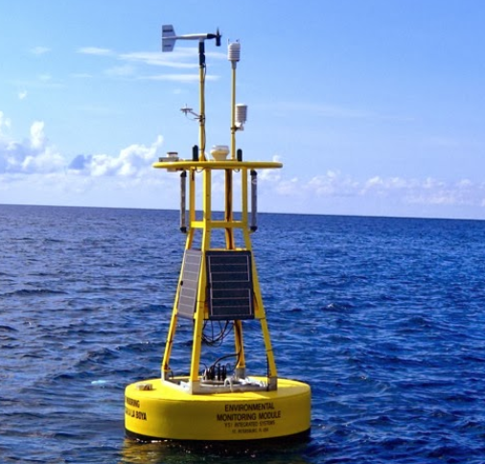
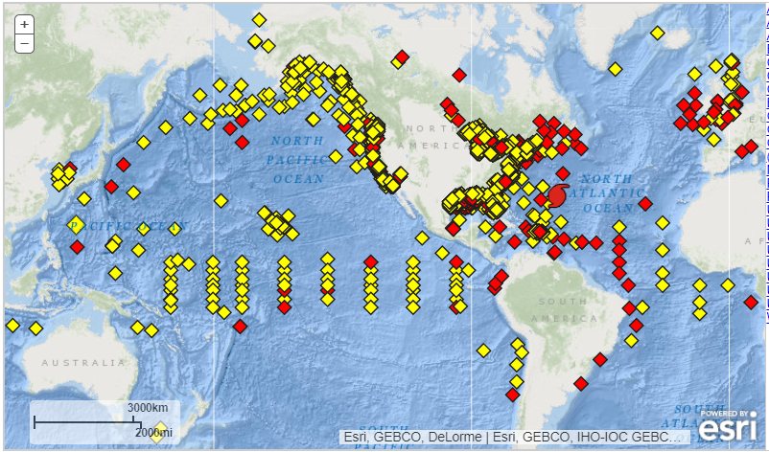

Genesis of Data
From National Data Buoy Center (https://www.ndbc.noaa.gov)
Selected 10 Buoys in the Gulf of Mexico to compile data from the period of 2005-2019
Standard Meteorological Data utilized from each buoy
Utilized Hurricane and Tropical Storm Lists to determine data related to storms and data not related to storms for predictive models

Slide 3
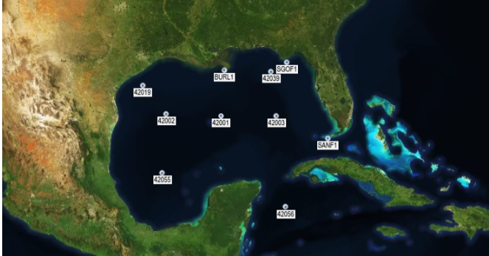

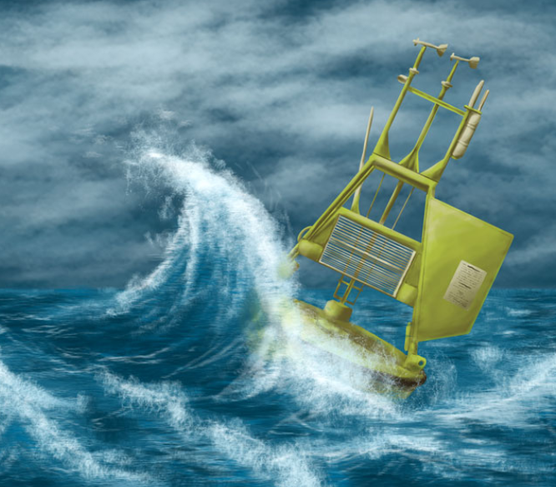
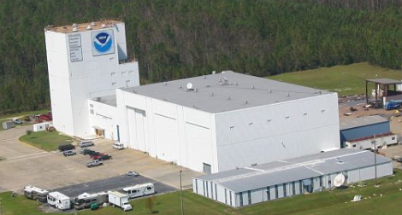
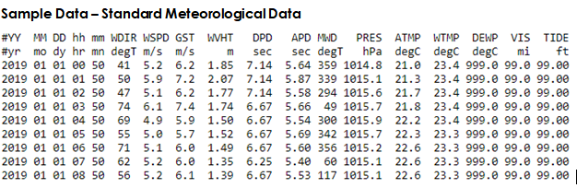
Transmission of Data
Buoy data is transmitted via Satellite to the National Data Buoy Center which collects, analyzes and sends out the data.

Slide 4

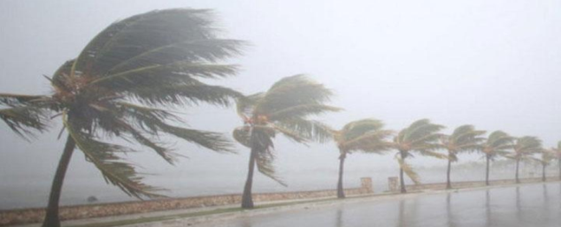
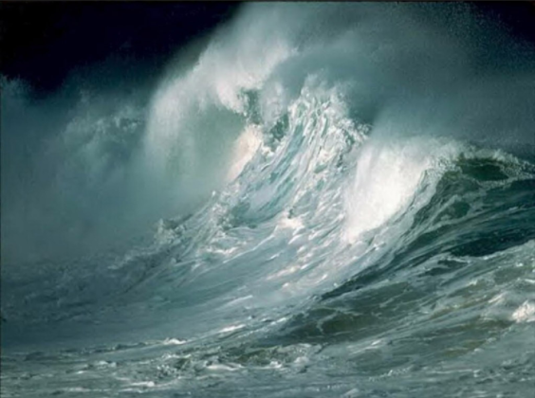
Data Elements Used
Key Data Elements
Water Temperature > 26 degrees Celsius (approximately 79 degrees Fahrenheit)
Wind Speed determines Storm Category
Wave Height relates to Storm Category

Slide 5


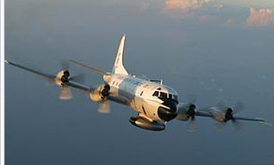
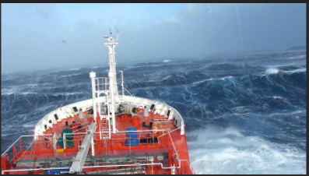
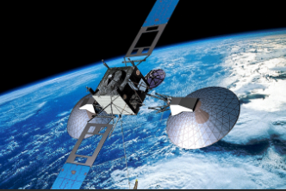
Additional Opportunities
Determined Limitations
Buoys 42003 (8/28 5am) and BURL1 (8/29 6am) were knocked out of commission during Hurricane Katrina. They did not have data from those dates thru mid-October 2005.
Hurricanes and Tropical Storms dating back to 1851 but buoy data did not go back that far.
Static Number was utilized for each hurricane category, we did not encompass the category changes of the hurricane throughout its lifecycle.
Buoys for the study may have not been close or in the path of each storms. They would be less useful and cause our model to learn inaccurately how to predict storms.
Other data sources are available such as Satellites, Storm Chaser Aircraft and ships at sea but we wanted to focus solely on buoy data for this project.

Slide 6
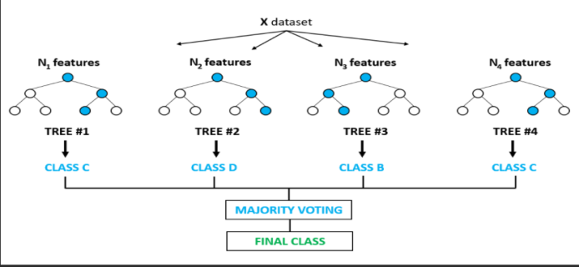
Machine Learning
For our model we used classification trees, both decision trees and random forests
Our classification trees are a series of data points, including our most important variables; water temperature, wind speed and wave height
Looked at a dataset that only had the buoy data from days there were storms (hurricanes or tropical storms) ,with the data from that particular storm or hurricane.
We looked at our full dataset that included the buoy data from days with storms (hurricanes or tropical storms), but also all of the buoy data from days without storms.
Opportunities/Limitations
Utilize Neural Networks for our Machine Learning
Buoy Data Outweighed Storm Data (Minimal Number of Gulf Storms in the last 15 years)

Slide 7


Utilizing Technologies Learned
Machine Learning Tools
Tools Utilized for Project
Python/Pandas
HTML/CSS Bootstrap
SQL Database
Tableau
Github
Scikit-Learn – Machine Learning Library
Random Forest Classifier

Slide 8
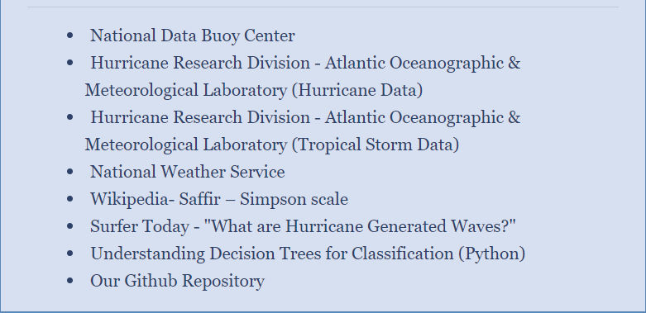
References

Slide 9

Thank you
Ruthy and Megan

